Slide 1

An EUDAT-based FAIR Data Approach for Data Interoperability

Slide 2
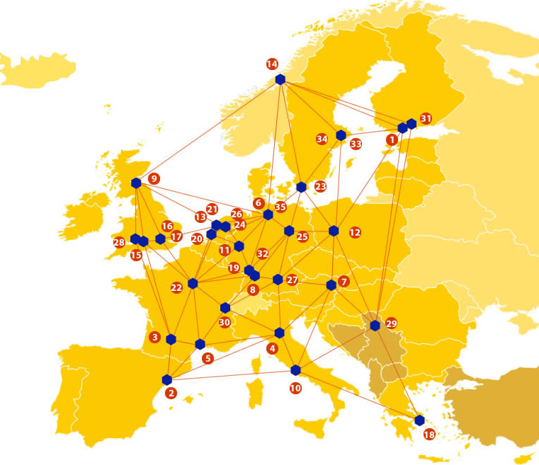

EUDAT: A truly pan-European Infrastructure
EUDAT offers common data services to both research communities and individuals through a network of 35 European organisations.
EUDAT wants to enable European researchers from any discipline to preserve, find, access, and process data in a trusted environment, as part of a Collaborative Data Infrastructure.
European infrastructures
Technology Providers
Research Communities

Slide 3

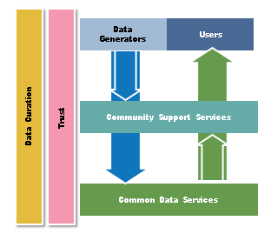
EUDAT Vision & Mission
Vision: Data is shared and preserved across borders and disciplines thereby enhancing the value and quality of research at large.
Mission: To enable data stewardship within and between European Research Communities through a Collaborative Data Infrastructure, a common model and service infrastructure for managing data spanning all European research data centres and community data repositories.

Slide 4
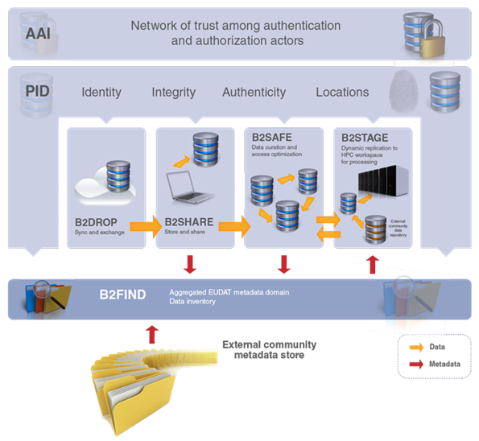










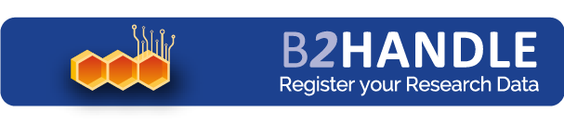



B2 Service Suite
Covering both access and deposit, from informal data sharing to long-term archiving, and addressing identification, discoverability and computability of both long-tail and big data, EUDAT services seek to address the full lifecycle of research data
https://www.eudat.eu/services
Notes:
B2FIND
stores metadata as well through other EUDAT services such as B2SHARE to provide access to data object within the EUDAT CDI
is used in inter-service use cases, e.g. to select links to data to be transferred to HPC platforms through B2STAGE

Slide 5
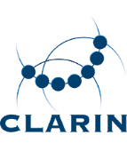





Building solutions with the communities
EUDAT services (B2 Service Suite) are designed, built and implemented together with user communites.
Common Language Resources and Technology Infrastructure (CLARIN)
European Network for Earth System Modelling (ENES)
Distributed infrastructure for life-science information (ELIXIR)
European Plate Observing System (EPOS) - Solid Earth sciences Research Infrastructure
Integrated Carbon Observation System (ICOS) to quantify & understand greenhouse gas balance
Long-Term Ecosystem Research (LTER) in Europe

Slide 6
The Challenges
Facilitate data findability, accessibility, interoperability and reusability (FAIR) across services, disciplines and domains.
Define a minimal set of guidelines, standards and best practices for the compliance to the FAIR Data Principles (http://www.nature.com/articles/sdata201618)
Life science data arguably represent one of the most heterogeneous, diverse and challenging type of research data

Slide 7
An EUDAT-based FAIR Data Approach for Data Interoperability: the Partners

Slide 8
An EUDAT-based FAIR Data Approach for Data Interoperability Pilot
In order to achieve data publication in a FAIR manner and foster their findability, accessibility, interoperability and reusability, a set of (FAIR) data tools are being developed,
including the FAIR Data Point (FDP), which is a software layer on top of datasets to expose them as FAIR (inter-linkable) data.
The FDP provides information about the available datasets in terms of their metadata as well as the actual access to the data in an interoperable format.
The pilot will evaluate whether current EUDAT services could be extended to behave as FDPs or a new FDP-based service should be proposed.

Slide 9

For additional information
http://www.eudat.eu/
Luiz Olavo Bonino, DTL, The Netherlands
Mark Thompson, LUMC, The Netherlands
luiz.bonino@dtls.nl / m.thompson@lumc.nl

